Slide 1
Datacenter Topology
Lecture 18 (Datacenters 1)
CS 168, Spring 2026 @ UC Berkeley
Slides credit: Sylvia Ratnasamy, Rob Shakir, Peyrin Kao, Ankit Singla, Murphy McCauley
Notes:
Slides template credit: Josh Hug, Lisa Yan

Slide 2
What is a Datacenter?
Designing Datacenters
What is a Datacenter?
Inside a Real Datacenter
Bisection Bandwidth
Topologies (Clos Networks)
Congestion Control in Datacenters
Lecture 18, CS 168, Spring 2026

Slide 3
What is a Datacenter?
Our model of the Internet so far: Your computer exchanges packets with a server.
Is YouTube really a single machine serving videos to the entire world? No.
Your computer
Home router
YouTube router
YouTube server
Internet

Slide 4
What is a Datacenter?
In reality: Large applications (e.g. YouTube, Facebook) are hosted in datacenters.
Datacenter: A building of inter-connected machines, hosting applications.
Our goal: How do we build network infrastructure to connect machines in the datacenter?
Our goal: Designing the stuff in here.
A building full of Google routers and servers
Datacenter
Your computer
Home router
Internet

Slide 5
What is a Datacenter?
So far, we've thought about general-purpose networks.
Example: UC Berkeley's network.
Hosts: Students' computers, servers in research labs.
Network infrastructure: Routers and links on campus.
Today, we'll think about datacenter networks.
Example: Google's datacenter.
Hosts: Servers running Google search, YouTube, Google Maps, etc.
Network infrastructure: ???
Unlike general-purpose networks we've seen so far, datacenter networks have unique constraints and specialized solutions.
Our goal: Designing this.

Slide 6
Why are Datacenters Different?
What makes datacenter network infrastructure different?
Exists in a single physical location (e.g. a building).
Centralized control: Operated by a single organization.
The operator has more control over the network and hosts (to some degree).
Homogenous: Every server and switch can be built and operated identically.
Contrast with Berkeley's network: Some links are wired, others are wireless.
Made possible because of centralized control.
High performance requirements: Need extremely high bandwidth, reliability, etc.
We'll focus on modern hyperscale datacenters (e.g. Google, Facebook, Amazon), but the concepts can scale down.

Slide 7
Datacenter Traffic Patterns
High performance is critical because the datacenter has lots of internal traffic.
Suppose you load the Facebook home page.
The one server you contact probably doesn't have all of Facebook's data.
That server needs to exchange traffic with other servers to answer your request.
Example: Fetch ads, photos, posts, etc. from other servers with that data.
Internal traffic between servers in the datacenter.
External traffic between you (the user) and datacenter.
Datacenter
Your computer
Home router
Internet

Slide 8
Datacenter Traffic Patterns
High performance is critical because the datacenter has lots of internal traffic.
A single request from the user might trigger lots of backend requests between datacenter servers.
Example: Loading a Facebook page.
Example: Big data analytics like MapReduce.
There's significantly more internal traffic (between machines) than external traffic (machine to user).
Sometimes, there's no user-facing traffic at all.
Example: A server backing up its data on another server.
Scaling Memcache at Facebook |  | Link
Rajesh Nishtala et. al. | USENIX NSDI, 2013
Loading one popular page requires 521 internal loads on average.
99th percentile = 1740 loads!

Slide 9
Datacenter Traffic Patterns
Terminology:
East-west traffic is internal, between machines.
North-south traffic is external, from the datacenter to elsewhere.
East-west traffic is several orders of magnitude larger than north-south traffic.
Internet
North-south
Datacenter
East-west

Slide 10
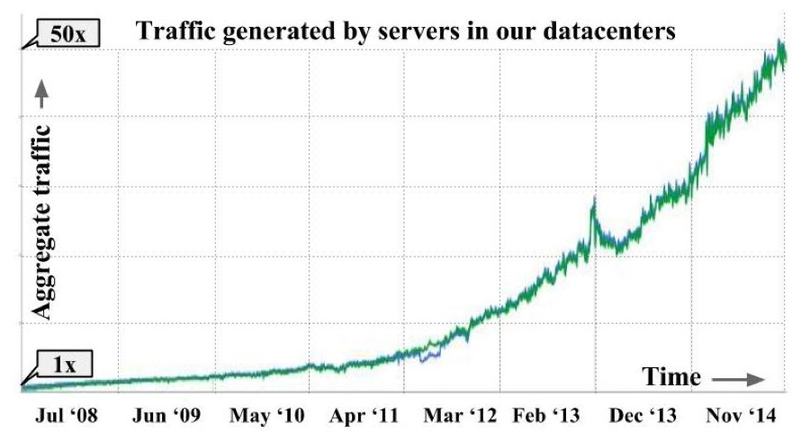
Datacenter Traffic Patterns
Datacenter traffic demand has increased significantly.
50x increase between 2008 and 2014!
“Jupiter Rising: A Decade of Clos Topologies and Centralized Control in Google’s Datacenter Network”, Arjun Singh et al. @ Google, ACM SIGCOMM’15

Slide 11
Inside a Real Datacenter
Designing Datacenters
What is a Datacenter?
Inside a Real Datacenter
Bisection Bandwidth
Topologies (Clos Networks)
Congestion Control in Datacenters
Lecture 18, CS 168, Spring 2026

Slide 12
Accessing an Application in a Datacenter
When you send a packet to the service (e.g. Facebook):
Your ISP forwards the packet through ISP-operated routers and links.
Eventually, the packet reaches a peering location.
The ISP hands the packet off to a Facebook-operated router.
Facebook forwards the packet through its own infrastructure to a datacenter.
Your computer
Home router
Datacenter
WAN
Peering
ISP-owned infrastructure
Facebook-owned infrastructure

Slide 13
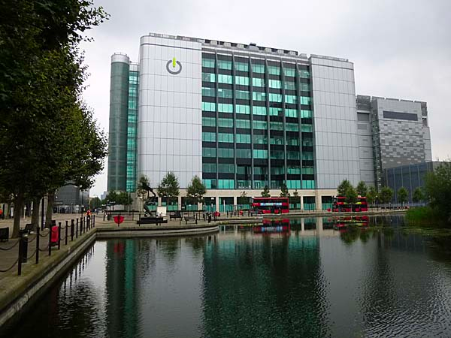
Internet Infrastructure: Peering Locations
Peering locations host network interconnection infrastructure.
Needs to be near other networks.
Often found in cities.
Applications and ISPs rent space here to install their routers.
Your computer
Home router
Datacenter
WAN
Peering
ISP-owned infrastructure
Facebook-owned infrastructure

Slide 14
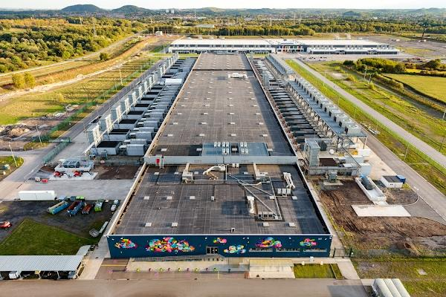
Internet Infrastructure: Datacenters
Datacenters host the servers and application infrastructure.
Doesn't need to be near other networks.
Often found in less-populated areas.
Constraints: Power, cooling, physical space.
Your computer
Home router
Datacenter
WAN
Peering
ISP-owned infrastructure
Facebook-owned infrastructure

Slide 15
Internet Infrastructure: The Big Picture
Datacenters host the servers and application infrastructure.
Peering locations host network interconnection infrastructure.
Facebook and the ISPs all install routers here.
Facebook's wide area network (WAN) connects its locations together.
The peering locations and datacenters could all be in different cities.
Our special datacenter networks connect servers inside here.
ISP
WAN
Datacenter
Peering
ISP
Datacenter
Peering
Datacenter
ISP
Facebook-owned infrastructure

Slide 16
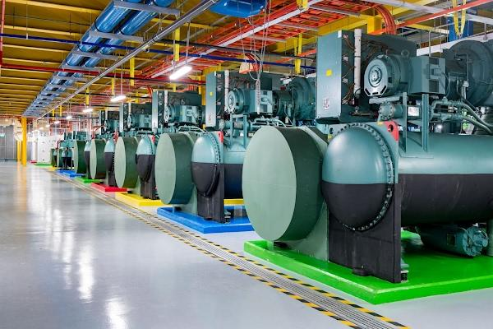
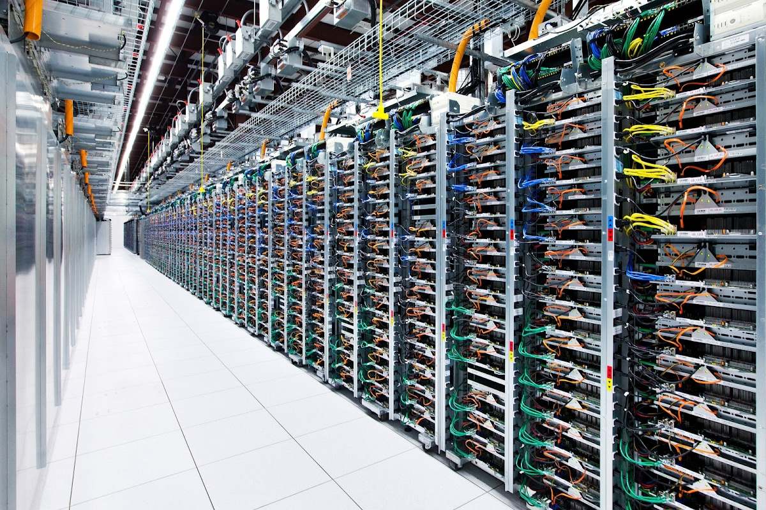
Internet Infrastructure: Datacenters
Datacenter locations are often chosen based on constraints:
Cooling: Near rivers.
Power: Near a power station.
Physical space: In less populated areas.
Infrastructure for cooling inside a Google datacenter.
Ultimately, a datacenter is just a building with a ton of servers. Our job is to build the network that connects the servers.

Slide 17
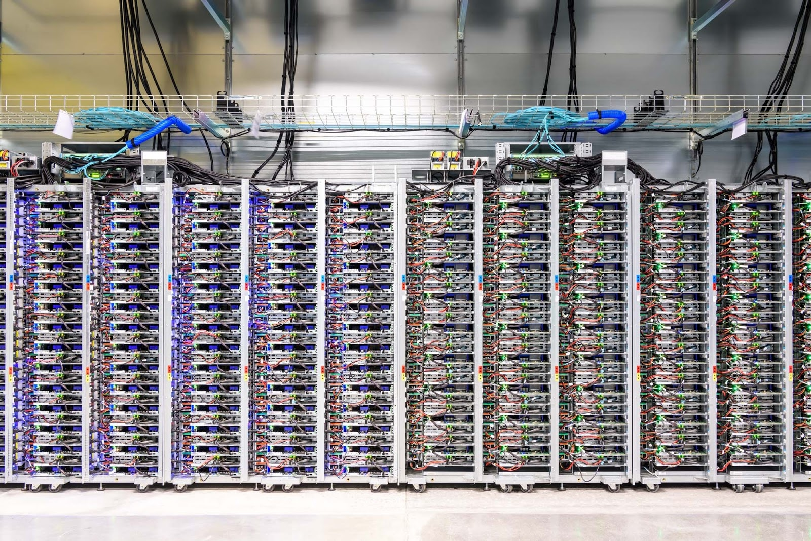
Inside a Datacenter: Racks
Inside a datacenter, servers are organized in physical racks.
Each rack has ~40 units (slots).
Each unit can fit 1–2 servers.
Each unit fits 1–2 servers.
~40 units in each rack.
Notes:
https://static.googleusercontent.com/media/research.google.com/en/us/archive/googlecluster-ieee.pdf

Slide 18
Inside a Datacenter: Top-of-Rack Switches
To connect all the servers in the same rack:
Each rack has a top-of-rack (TOR) switch.
Every server in the rack has an access link (uplink) connecting to that switch.
Each server uplink is ~100 Gbps.
TOR switch
Uplinks in blue
TOR
Forwarding Chip
…
100 Gbps
100 Gbps
100 Gbps
100 Gbps
100 Gbps

Slide 19
Inside a Datacenter: Connecting Racks?
We built a rack of 40–80 servers, and connected all the servers in the rack.
Each datacenter has many racks.
How do we connect the racks together?
But first...how do we measure if our chosen topology is good?

Slide 20
Bisection Bandwidth
Designing Datacenters
What is a Datacenter?
Inside a Real Datacenter
Bisection Bandwidth
Topologies (Clos Networks)
Congestion Control in Datacenters
Lecture 18, CS 168, Spring 2026

Slide 21
Measuring Network Connectivity
Before we think about connecting racks, we need a way to measure connectedness.
All 3 topologies below are fully-connected.
1 is "more connected" than 2, and 2 is "more connected" than 3.
Bisection bandwidth is a way to formally measure how connected a network is.
R1
R4
R1
R4
R1
R4
R2
R5
R2
R5
R2
R5
R3
R6
R3
R6
R3
R6
Topology 1
Topology 2
Topology 3

Slide 22
Bisection Bandwidth
To compute bisection bandwidth:
Delete links until the network is partitioned into two halves.
Delete the minimum number of links necessary (don't just delete everything).
Add up the bandwidths on all the deleted links.
Intuition: If the network is more connected, we have to delete more links to split it.
R1
R4
R1
R4
R1
R4
R2
R5
R2
R5
R2
R5
R3
R6
R3
R6
R3
R6
Assume each link is 1 Gbps.
9 Gbps
3 Gbps
1 Gbps

Slide 23
Bisection Bandwidth
Another equivalent definition of bisection bandwidth:
Partition the network into two halves.
All hosts in one half want to simultaneously send data to the other half.
What is the minimum bandwidth the nodes can collectively send at?
"Minimum" = In the worst-case partition.
Intuition: This is the bottleneck bandwidth of the network.
R1
R4
R1
R4
R1
R4
R2
R5
R2
R5
R2
R5
R3
R6
R3
R6
R3
R6
Assume each link is 1 Gbps.
9 Gbps
3 Gbps
1 Gbps

Slide 24
Full Bisection Bandwidth1
Full bisection bandwidth: All hosts in one partition can send at full rate.
If N nodes can each send at R, full bisection bandwidth = N/2 × R.
Oversubscription is a measure of how overloaded the network is.
Ratio of full bisection bandwidth, to actual bisection bandwidth.
Intuition: This tells us how far from the full bisection bandwidth we are.
A
A
1
B
A
B
1
1
1
1
Assume all links 1 Gbps.
B
C
C
1
D
C
D
10
10
10
10
D
E
E
F
E
F
G
H
I
J
K
L
Full: 10 Gbps
Bisection: 1 Gbps
Over: 10x
Full: 10 Gbps
Bisection: 2 Gbps
Over: 5x
Full: 4 Gbps
Bisection: 2 Gbps
Over: 2x

Slide 25
Datacenter Topologies (Clos Networks)
Designing Datacenters
What is a Datacenter?
Inside a Real Datacenter
Bisection Bandwidth
Topologies (Clos Networks)
Congestion Control in Datacenters
Lecture 18, CS 168, Spring 2026

Slide 26
Maximizing Bisection Bandwidth
Back to our original problem:
We were looking for a way to connect racks to each other.
As we've seen, bisection bandwidth is a function of network topology.
In the datacenter, we can choose the topology relatively easily.
Remember: A single operator controls the network.
They can build whatever cables they want.
What topology do we build to maximize connectivity (bisection bandwidth)?

Slide 27
Topology #1: Big Switch
Problem 1: High switching speed needed.
In a modern data center, 100,000 servers × 40 Gbps = 4 petabits per second!
Problem 2: Large radix. The switch needs a large number of (physical) ports.
1 port per rack. In a modern datacenter, ~2500 racks.
Large switch

Slide 28
Topology #1: Big Switch
A single big switch scales poorly.
Impossible to build a switch with the needed capacity.
Even if we could build this switch, it would be way too expensive.
If the switch goes down, everything stops working.
Google tried to build this. It didn't go so well.
via Urs Hölzle (Google) on LinkedIn | Link
But what we needed was a 10,000 port switch that cost $100/port. So, almost exactly 20 years ago, we sent this 5-page RFP to four different switch vendors (IIRC: Cisco, Force10, HP, and Quanta) and tried to interest them in building such a switch. They politely declined because "nobody is asking for such a product except you", and they anticipated margins to be low.
10K Gigabit Ethernet Switch Request for Proposal |  | Link
Google | 2004
This section attempts to explain why we believe it is possible to build a 10,000 port non-blocking switch for $100/port.

Slide 29
Topology #2: Tree
A tree topology solves our problems:
Problem 1: Reduced bandwidth.
Problem 2: Reduced radix.
Problem: Low bisection bandwidth.
Bottleneck is 100 Gbps.
Full bisection bandwidth is 300 Gbps.
Network is 3x oversubscribed.
100 Gbps links

Slide 30
Topology #3: Fat Tree
Increase link bandwidth at the top layer.
Problem 1 returns: Top switch needs high link speed and switching capacity.
Problem 2 solved: Reduced radix.
This can be used.
But the top switch will be expensive and scale poorly.
300 Gbps links
100 Gbps links

Slide 31
Clos Networks
Instead of custom-built switches, use commodity switches to build networks.
Off-the-shelf switches are cheap.
Every switch is identical.
Same number of ports.
Same link speeds.

Slide 32
Clos Networks
High performance comes from creating many paths.
Ideally, any two hosts talking can use a dedicated path.

Slide 33
Folded Clos Networks
So far, we've drawn sender racks on the left, and recipient racks on the right.
In real networks, each rack could be both sender and recipient.
In a folded Clos network, traffic flows into the network, and then back out.
Links are bidirectional.
Clos Network
Folded Clos Network

Slide 34
Topology #4: Fat Tree Clos Network
Idea: Combine the tree and the folded Clos network.
A Scalable, Commodity Data Center Network Architecture |  | Link
Mohammad Al-Fares, Alexander Loukissas, Amin Vahdat | SIGCOMM 2008
Core layer
Aggregation layer
Edge layer
Pod 1
Pod 2
Pod 3
Pod 4
k = 4

Slide 35
Topology #4: Fat Tree Clos Network
A k-ary fat tree has k pods.
Each pod has k switches.
k/2 switches in the upper aggregation layer.
k/2 switches in the lower edge layer.
Core layer
Aggregation layer
Edge layer
Pod 1
Pod 2
Pod 3
Pod 4
k = 4

Slide 36
Topology #4: Fat Tree Clos Network
Each switch has k links. Half connect up, and half connect down.
Edge layer:
k/2 links connect up to all aggregation switches in the same pod.
k/2 links connect down to servers.
Aggregation layer:
k/2 links connect up to core layer.
k/2 links connect down to all edge switches in the same pod.
Core layer
2 up to core.
2 down to edge.
2 up to aggregation.
2 down to servers.
Aggregation layer
Edge layer
k = 4
Pod 1
Pod 2
Pod 3
Pod 4
k = 4

Slide 37
Topology #4: Fat Tree Clos Network
A k-ary fat tree has:
(k/2)² servers per pod. (k/2 edge switches, each has k/2 links down to servers.)
(k/2)² core switches. Each has k links down to pods.
Core layer
4 down to pods.
Aggregation layer
Edge layer
Pod 1
Pod 2
Pod 3
Pod 4
k = 4

Slide 38
Topology #4: Fat Tree Clos Network
A k-ary fat tree has:
k pods. Each pod has k switches, half in each layer.
Each switch has k links, half up and half down.
(k/2)² servers per pod.
(k/2)² core switches. Each has k links down to pods.
Core
Aggregation
Edge
Pod 1
Pod 2
Pod 3
Pod 4
Pod 5
Pod 6
k = 6

Slide 39
Topology #4: Fat Tree Clos Network – Bisection Bandwidth
Achieves full bisection bandwidth.
Each host in left half has a dedicated path to each host in right half.
Core layer
Aggregation layer
Edge layer
Pod 1
Pod 2
Pod 3
Pod 4
k = 4

Slide 40
Topology #4: Fat Tree Clos Network – Bisection Bandwidth
Achieves full bisection bandwidth.
Must cut 8 links to disconnect network.
8 hosts in left each use one of those links to 8 hosts in right.
Core layer
Aggregation layer
Edge layer
Pod 1
Pod 2
Pod 3
Pod 4
k = 4

Slide 41
Topology #4: Fat Tree Clos Network – Racks
The servers and switches inside a pod can be organized into racks.
k = 48:
k/2 = 24 aggregation switches
k/2 = 24 edge switches
(k/2)² = 576 servers per pod
Pod
48 servers
48 servers
48 servers
48 servers
48 servers
48 aggregation and edge switches
48 servers
48 servers
48 servers
48 servers
48 servers
48 servers
48 servers
See the paper for a more detailed description.

Slide 42
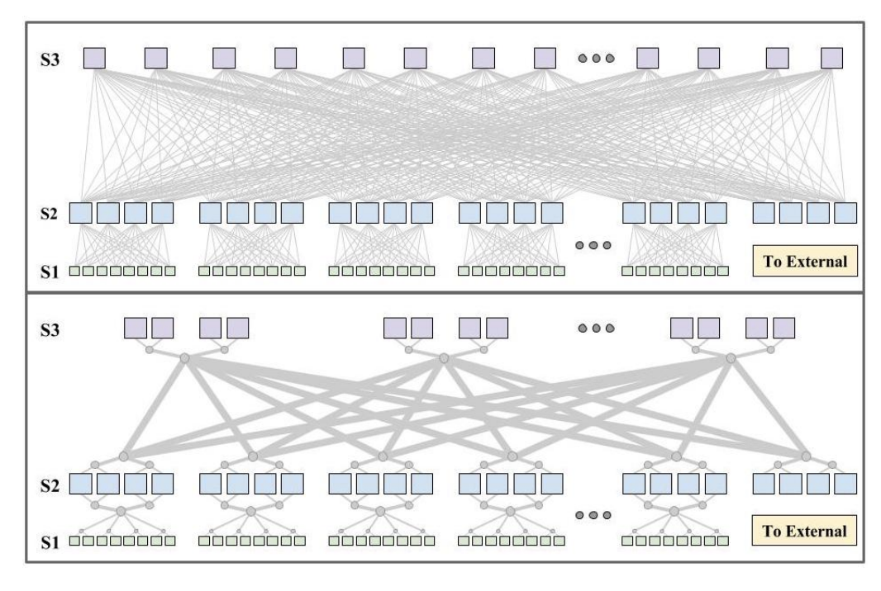
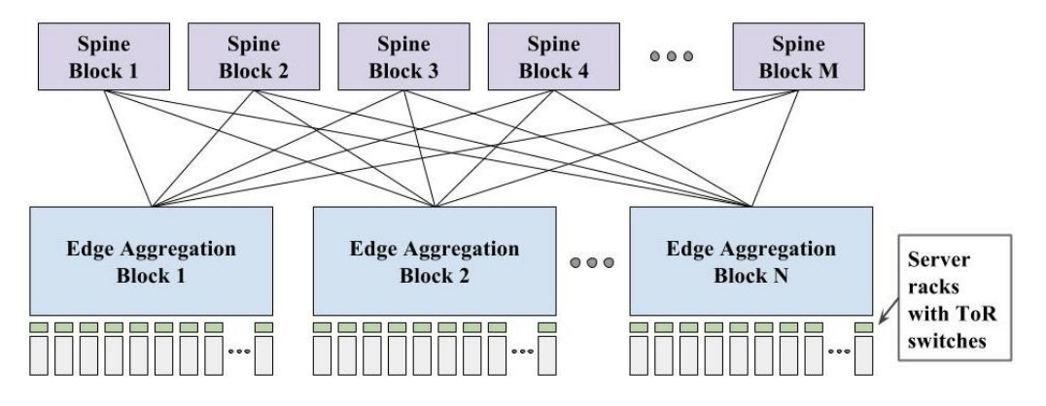
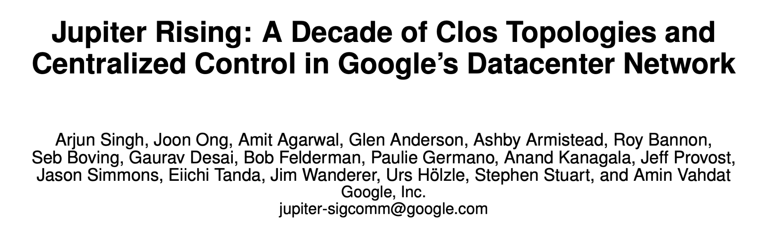
Evolution of Clos Networks for DC
ACM SIGCOMM 2015

Slide 43
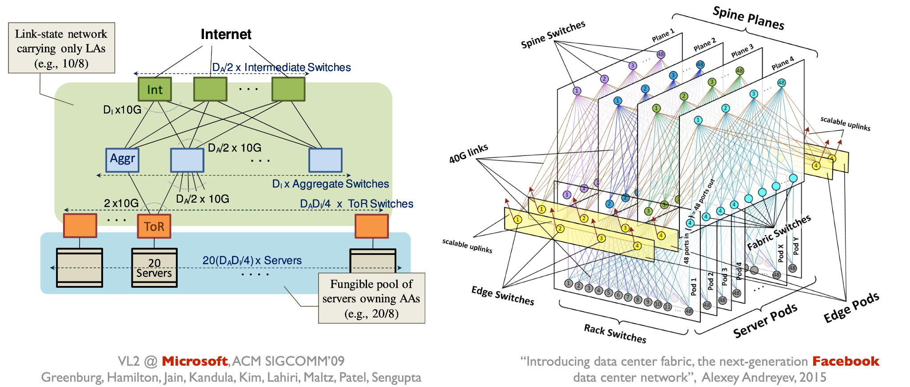
Design Variants are Common

Slide 44
Congestion Control in Datacenters
Designing Datacenters
What is a Datacenter?
Inside a Real Datacenter
Bisection Bandwidth
Topologies (Clos Networks)
Congestion Control in Datacenters
Lecture 18, CS 168, Spring 2026

Slide 45
Why are Datacenters Different? (1/2) – Queuing Delay
Recall: Packet delay is the sum of 3 values.
Transmission delay:
Small in datacenters. High-capacity links.
Larger in the general Internet.
Propagation delay:
Small in datacenters. Everything in the same building.
Much larger in the general Internet (e.g. undersea cables).
Queuing delay:
In the wider Internet, usually insignificant compared to the other delays.
In datacenters, queuing is often the dominant source of delay.
General Internet:
Datacenters:
Transmission + Propagation + Queuing
Transmission + Propagation + Queuing

Slide 46
Why are Datacenters Different? (1/2) – Queuing Delay
Example:
Transmission delay = 0.8 μs per hop.
Assume 1000-byte packets and 10 Gbps links.
Queuing delay = 40 μs.
Assume 10 packets in queue, on average.
10 packets × 0.8 μs transmission per packet = 8 μs spent in queue.
8 μs per queue × 5 queues = 40 μs.
Propagation delay:
In the general Internet, 10ms–100ms.
In a datacenter, 10 μs.
Total delay:
In the general Internet: 0.8 μs + 40 μs + 100 ms → propagation dominates.
In a datacenter: 0.8 μs + 40 μs + 10 μs → queuing dominates.

Slide 47
Why are Datacenters Different? (2/2) – Types of Flows
Problem: TCP deliberately tries to fill up queues.
Recall: TCP increases rate until the queue is full and packets are dropped.
The problem is worse in datacenters, where there are limited types of flows.
Most flows are mice: short and latency-sensitive.
Example: Queries for web search.
Some flows are elephant: very large, and throughput-sensitive.
Example: Storage backups.
Elephant flows fill up the queues, causing mice to get stuck in queues.

Slide 48
Datacenter Congestion Control
Congestion control in datacenters is special because:
Queuing is the dominant source of delay.
Mice flows are stuck behind elephant flows.
Recall: Datacenters are constrained environments.
Single operator means we have more control over the hosts and networks.
Leads to the opportunity for innovation to exploit the network characteristics.
Datacenter-specific congestion control algorithms:
BBR: React to delay, not loss.
DCTCP: Router feedback.
pFabric: Packet priorities.

Slide 49
Datacenter Congestion Control (1/3) – BBR
BBR (Google) reacts to delay instead of loss.
Measure RTTs. When RTTs increase, slow down.
We can detect congestion before the queues fill up.

Slide 50
Datacenter Congestion Control (2/3) – DCTCP
DCTCP (Microsoft, 2010) reacts to explicit feedback from routers.
Recall the ECN (Explicit Congestion Notification) bit:
Routers mark packets when queue length exceeds a threshold.
Senders slow down if the bit is set.
Not widely-deployed in the Internet.
Well-suited for datacenters:
Requires a fairly simple change at hosts and routers.
Datacenter control ensures we can update all hosts and routers to use ECN.
Additional modifications:
Routers start marking packets earlier. Allows senders to adapt earlier.
Senders cut rate in proportion to number of packets with ECN markings. Allows senders to adapt more gently.

Slide 51
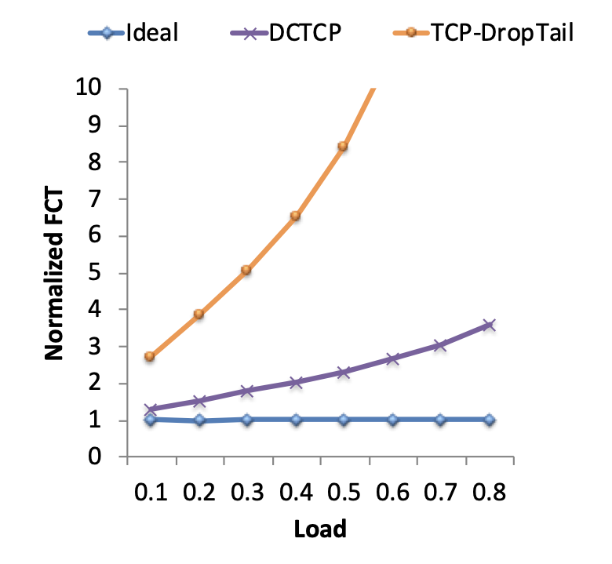
Datacenter Congestion Control (2/3) – DCTCP Performance
We can measure performance with FCT (flow completion time):
Time from flow starting, to last byte being received at the destination.
Our benchmark is the ideal FCT:
FCT using a omniscient scheduler with global knowledge, and schedules flows to minimize FCT.
Normalized FCT = FCT / ideal FCT.
How much longer am I than ideal?

Slide 52
Datacenter Congestion Control (3/3) – pFabric
Goal: Give mice a way to skip to the front of the queue.
Packets carry a single priority number in the header.
Priority = remaining flow size (number of unacknowledged bytes).
Lower number = higher priority.
Result: Mice have high priority.
Implementation:
Switches send highest priority packet, and drop lowest priority packet.
Senders transmit at full rate (no adjustments).
Only drop transmission rate under extreme loss (timeouts).
Requires non-trivial changes at both routers and end hosts.

Slide 53
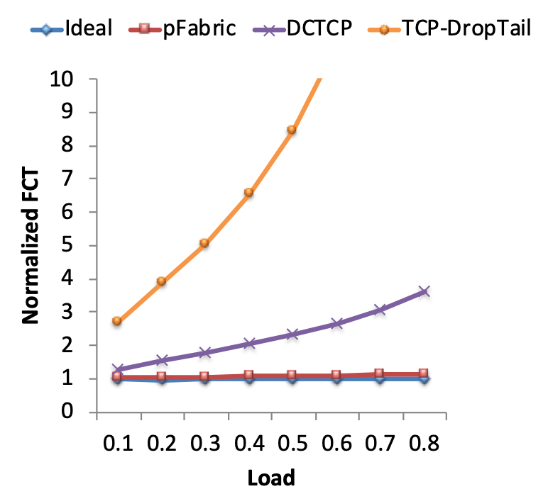
Datacenter Congestion Control (3/3) – pFabric Performance
pFabric performs even better than DCTCP, and close to ideal!
Good example of network and host co-design.
But, practically harder to realize, since it requires full control.

Slide 54
Datacenter Congestion Control (3/3) – pFabric Performance
Why does pFabric work so well?
High throughput:
Elephant and mice travel together.
Senders transmit at full rate. No wasting time on slow start.
Low latency for mice (high priority).
De-prioritizing low-priority packets avoids collapses.

Slide 55
Summary: Datacenters
Datacenters are single organization, multi-application environments.
A key criteria is high any-to-any bandwidth.
We characterize this as bisection bandwidth.
The topology of the datacenter must be designed to both be scalable, and cost-efficient.
Some technologies (e.g. congestion control) can be optimized based on the characteristics of datacenters.

